Slide 1
Guide to Computer Forensics and Investigations Sixth Edition Chapter 5
Working with Windows and CLI Systems
Notes:
Guide to Computer Forensics and Investigations Sixth Edition
Chapter 5
Working with Windows and CLI Systems

Slide 2
Objectives
Explain the purpose and structure of file systems
Describe Microsoft file structures
Explain the structure of NTFS disks
List some options for decrypting drives encrypted with whole disk encryption
Explain how the Windows Registry works
Describe Microsoft startup tasks
Explain the purpose of a virtual machine

Slide 3
Understanding File Systems

Slide 4
Understanding File Systems
File system
Gives OS a road map to data on a disk
Type of file system an OS uses determines how data is stored on the disk
When you need to access a suspect’s computer to acquire or inspect data
You should be familiar with both the computer’s OS and file systems

Slide 5
Understanding the Boot Sequence (1 of 3)
Complementary Metal Oxide Semiconductor (CMOS)
Computer stores system configuration and date and time information in the CMOS
When power to the system is off
Basic Input/Output System (BIOS)
Contains programs that perform input and output at the hardware level
Contain Bootstrap program
Change CMOS data
Extensible Firmware Interface (EFI)/UEFI is the updated version of BIOS
What is Firmware?
Software on hardware chips

Slide 6
Understanding the Boot Sequence (2 of 3)
Bootstrap process
Contained in ROM (part of BIOS), tells the computer how to proceed
https://www.youtube.com/watch?v=PSnGuvylWBI
CMOS should be modified to boot from a forensic floppy disk or CD
https://www.computerhope.com/issues/ch001360.htm
https://www.youtube.com/watch?v=P-zWXbPh_dg

Slide 7
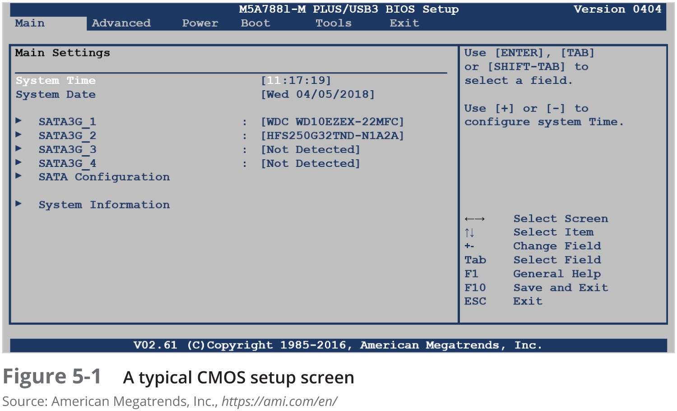
Understanding the Boot Sequence (3 of 3)

Slide 8
Understanding Disk Drives (1 of 4)
Disk drives are made up of one or more platters coated with magnetic material
Disk drive components
Geometry
Head
Tracks
Cylinders
Sectors

Slide 9
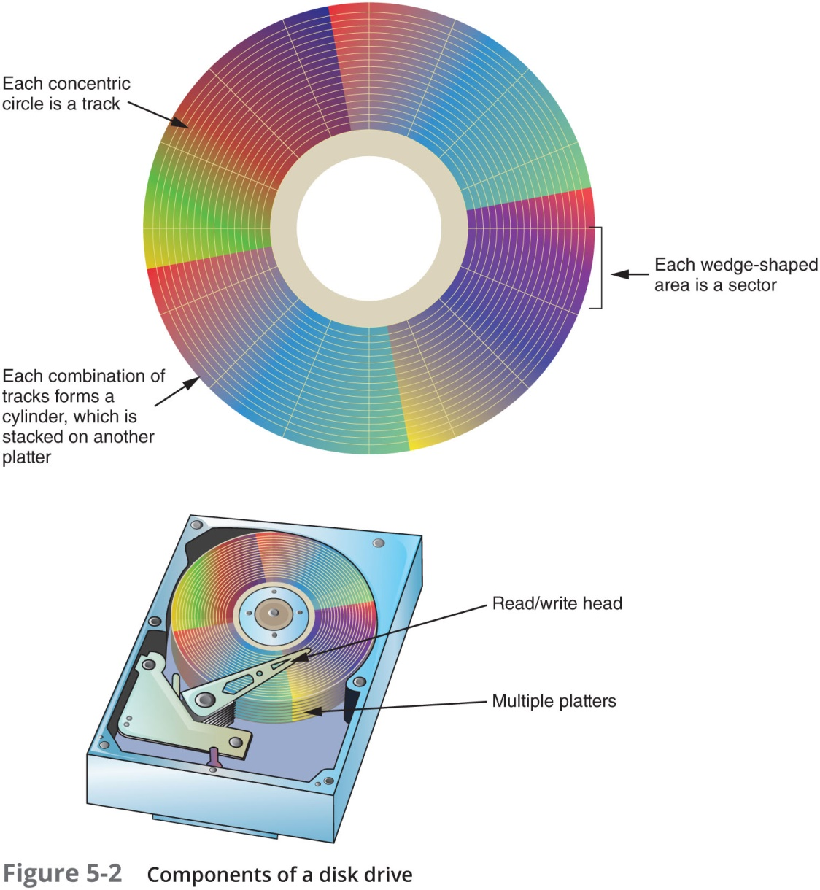
Understanding Disk Drives (2 of 4)

Slide 10
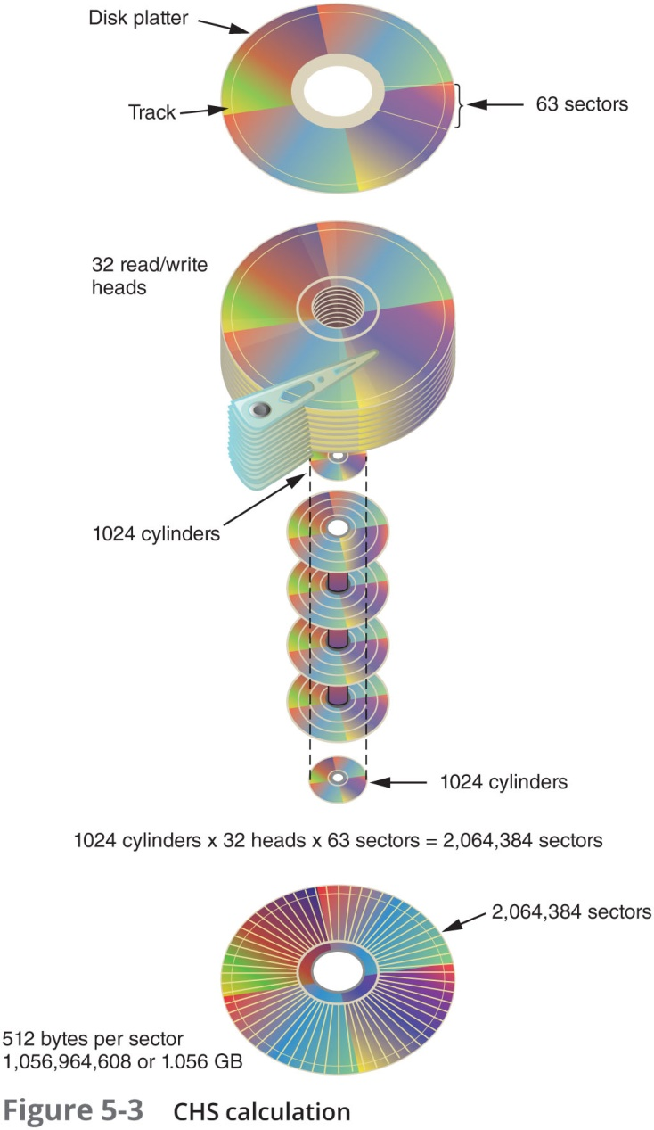
Understanding Disk Drives (3 of 4)
www.youtube.com/watch?v=gd5vKobmZ3Q&t=92s

Slide 11
Understanding Disk Drives (4 of 4)
Properties handled at the drive’s hardware or firmware level
Zone bit recording (ZBR)
Track density
Areal density
Head and cylinder skew

Slide 12
Solid-State Storage Devices
https://www.youtube.com/watch?v=DFbgoPraurM
All flash memory devices have a feature called wear-leveling
An internal firmware feature used in solid-state drives that ensures even wear of read/writes for all memory cells
When dealing with solid-state devices, making a full forensic copy as soon as possible is crucial
In case you need to recover data from unallocated disk space

Slide 13
Exploring Microsoft File Structures

Slide 14
Exploring Microsoft File Structures
Most PCs are Window OP
You should understand Window file systems
Two main types
FAT and NTFS

Slide 15
Exploring Microsoft File Structures (1 of 2)
In Microsoft file structures, sectors are grouped to form clusters
Storage allocation units of one or more sectors
Clusters range from 512 bytes up to 32,000 bytes each
Combining sectors minimizes the overhead of writing or reading files to a disk

Slide 16
Exploring Microsoft File Structures (2 of 2)
Clusters are numbered sequentially starting at 0 in NTFS and 2 in FAT
First sector of all disks contains a system area, the boot record, and a file structure database
OS assigns these cluster numbers, called logical addresses
Sector numbers are called physical addresses
Clusters and their addresses are specific to a logical disk drive, which is a disk partition

Slide 17
Disk Partitions (1 of 3)
A partition is a logical drive
Windows OSs can have three primary partitions followed by an extended partition that can contain one or more logical drives
Hidden partitions
De-reference partitions
Partition gap
Unused space between partitions

Slide 18
Disk Partitions (2 of 3)
The partition table is in the Master Boot Record (MBR)
Located at sector 0 of the disk drive
https://www.youtube.com/watch?v=vMB8uyosdOA
In a hexadecimal editor, such as WinHex, you can find the first partition at offset 0x1BE
The file system’s hexadecimal code is offset 3 bytes from 0x1BE for the first partition

Slide 19
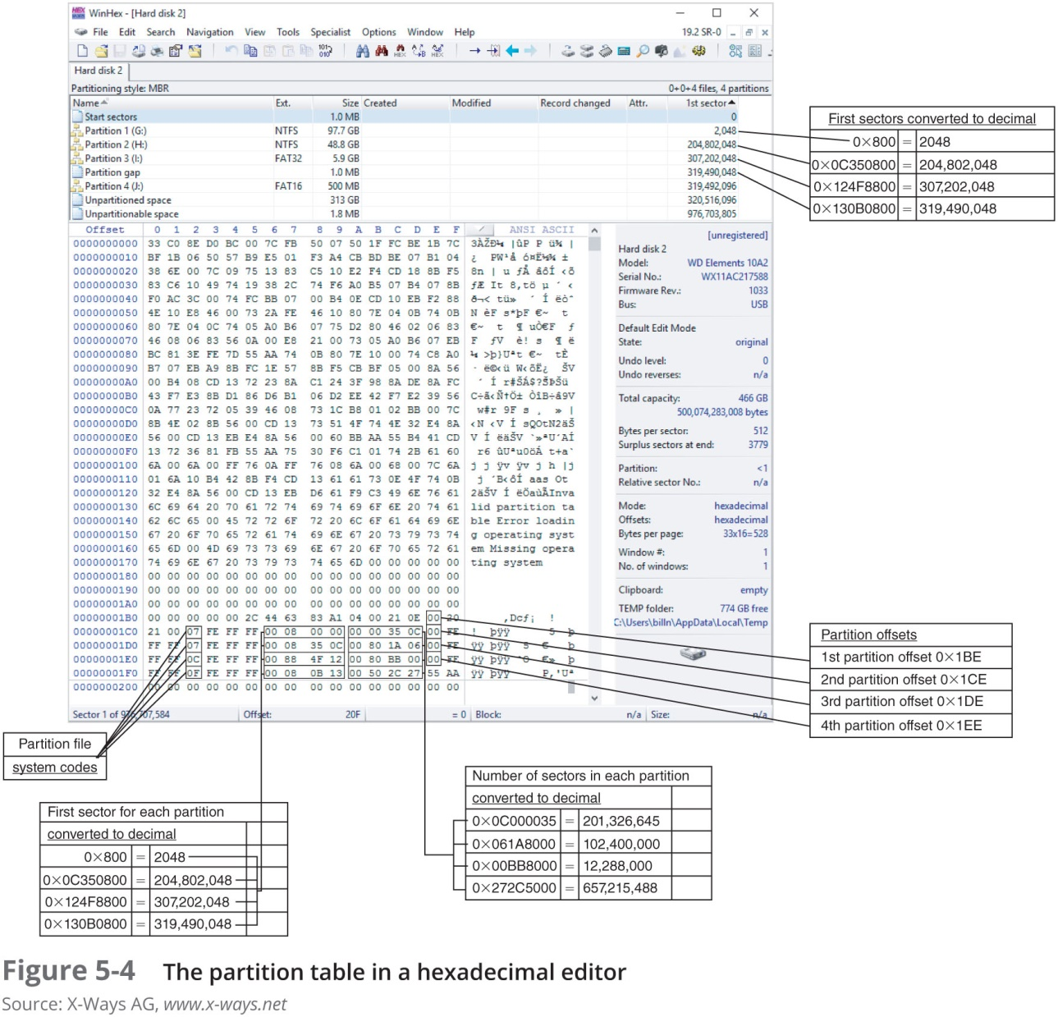
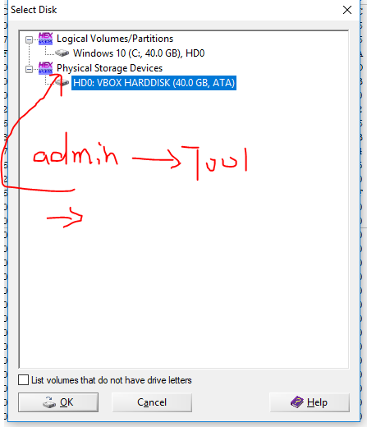
Disk Partitions (3 of 3)
There is an error in the table. Can you find it?
Notes:
View->

Slide 20
How to Compute the size of the 1st Partition(97.7G)?
Size of first partition=0x350000= 2,048,000,000 Bytes
1K=1024 Bytes
1M=1024 K
1G=1024 M
2,048,000,000 Bytes=97.65625G

Slide 21
Examining FAT Disks (1 of 7)
File Allocation Table (FAT)
File structure database that Microsoft originally designed for floppy disks
FAT database is typically written to a disk’s outermost track and contains:
Filenames, directory names, date and time stamps, the starting cluster number, and file attributes
Three current FAT versions
FAT16, FAT32, and exFAT (used for mobile personal storage devices)
Cluster sizes vary according to the hard disk size and file system

Slide 22
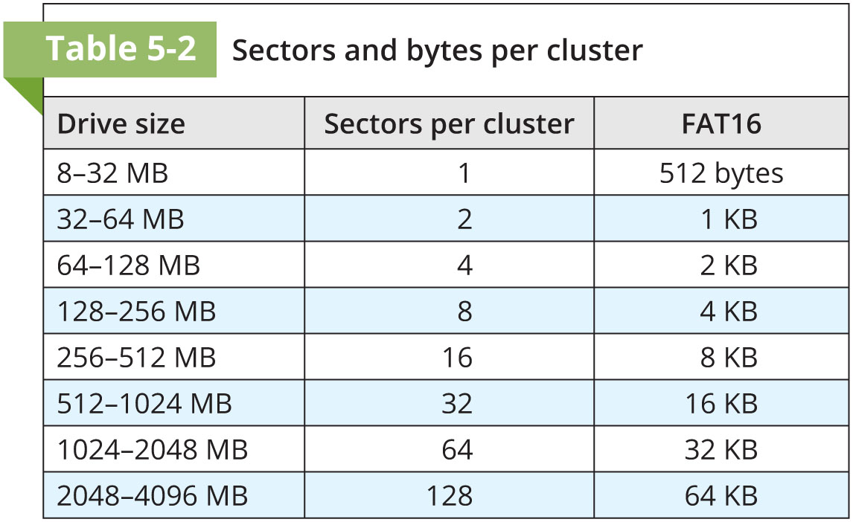
Examining FAT Disks (2 of 7)

Slide 23
Examining FAT Disks (3 of 7)
Microsoft OSs allocate disk space for files by clusters
Results in drive slack
Unused space in a cluster between the end of an active file’s content and the end of the cluster
Drive slack includes:
RAM slack and file slack
An unintentional side effect of FAT16 allowing large clusters was that it reduced fragmentation
As cluster size increased

Slide 24
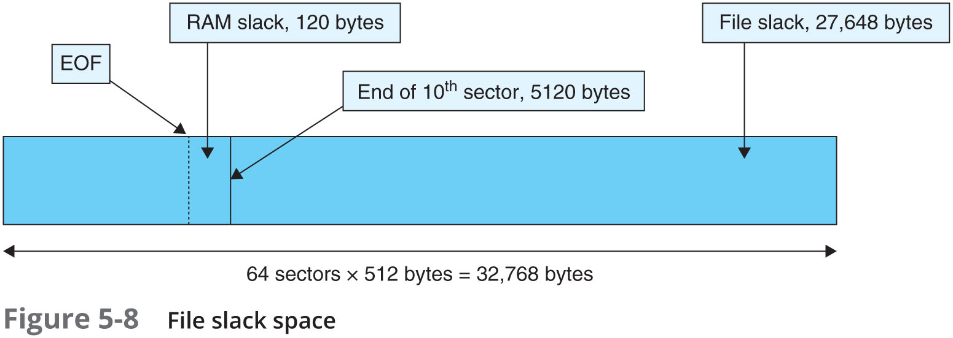
Examining FAT Disks (4 of 7)

Slide 25
Examining FAT Disks (5 of 7)
When you run out of room for an allocated cluster
OS allocates another cluster for your file
As files grow and require more disk space, assigned clusters are chained together
The chain can be broken or fragmented
When the OS stores data in a FAT file system, it assigns a starting cluster position to a file
Data for the file is written to the first sector of the first assigned cluster

Slide 26
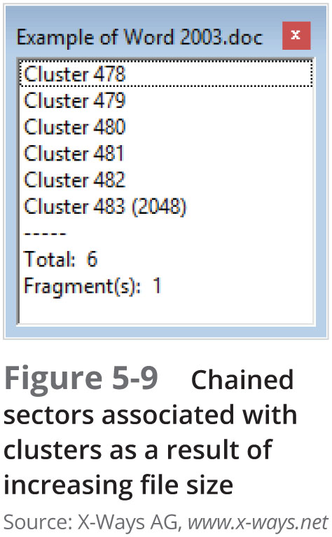
Examining FAT Disks (6 of 7)

Slide 27
Examining FAT Disks (7 of 7)
When this first assigned cluster is filled and runs out of room
FAT assigns the next available cluster to the file
If the next available cluster isn’t contiguous to the current cluster
File becomes fragmented

Slide 28
Deleting FAT Files
In Microsoft OSs, when a file is deleted
Directory entry is marked as a deleted file
With the HEX E5 character replacing the first letter of the filename
FAT chain for that file is set to 0
Data in the file remains on the disk drive
Area of the disk where the deleted file resides becomes unallocated disk space
Available to receive new data from newly created files or other files needing more space

Slide 29
Examining NTFS Disks (1 of 3)
NT File System (NTFS)
Introduced with Windows NT
Primary file system for Windows 10
Improvements over FAT file systems
NTFS provides more information about a file
NTFS gives more control over files and folders
NTFS was Microsoft’s move toward a journaling file system
It records a transaction before the system carries it out

Slide 30
Examining NTFS Disks (2 of 3)
In NTFS, everything written to the disk is considered a file
On an NTFS disk
First data set is the Partition Boot Sector
Next is Master File Table (MFT)
NTFS results in much less file slack space
Clusters are smaller for smaller disk drives
NTFS also uses Unicode
An international data format

Slide 31
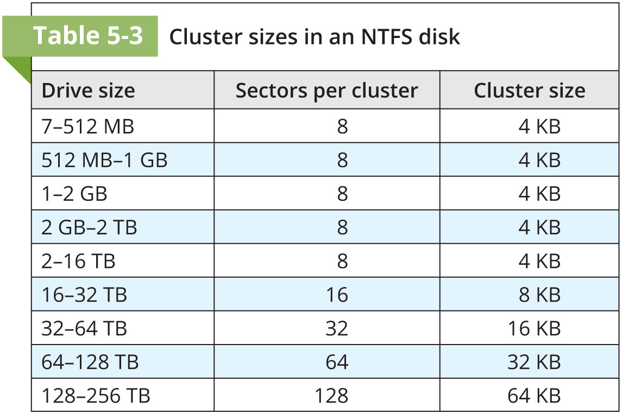
Examining NTFS Disks (3 of 3)

Slide 32
NTFS System Files (1 of 3)
MFT contains information about all files on the disk
Including the system files the OS uses
In the MFT, the first 15 records are reserved for system files
Records in the MFT are called metadata

Slide 33
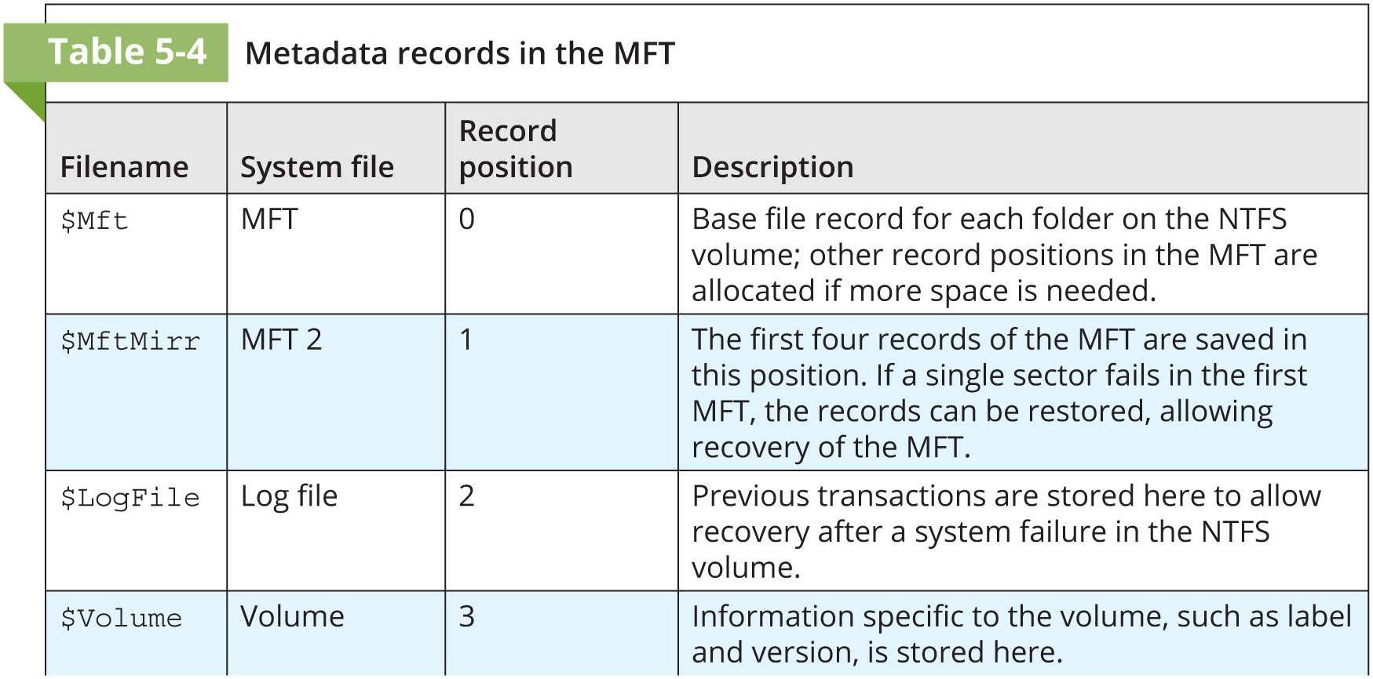
NTFS File System (2 of 3)

Slide 34
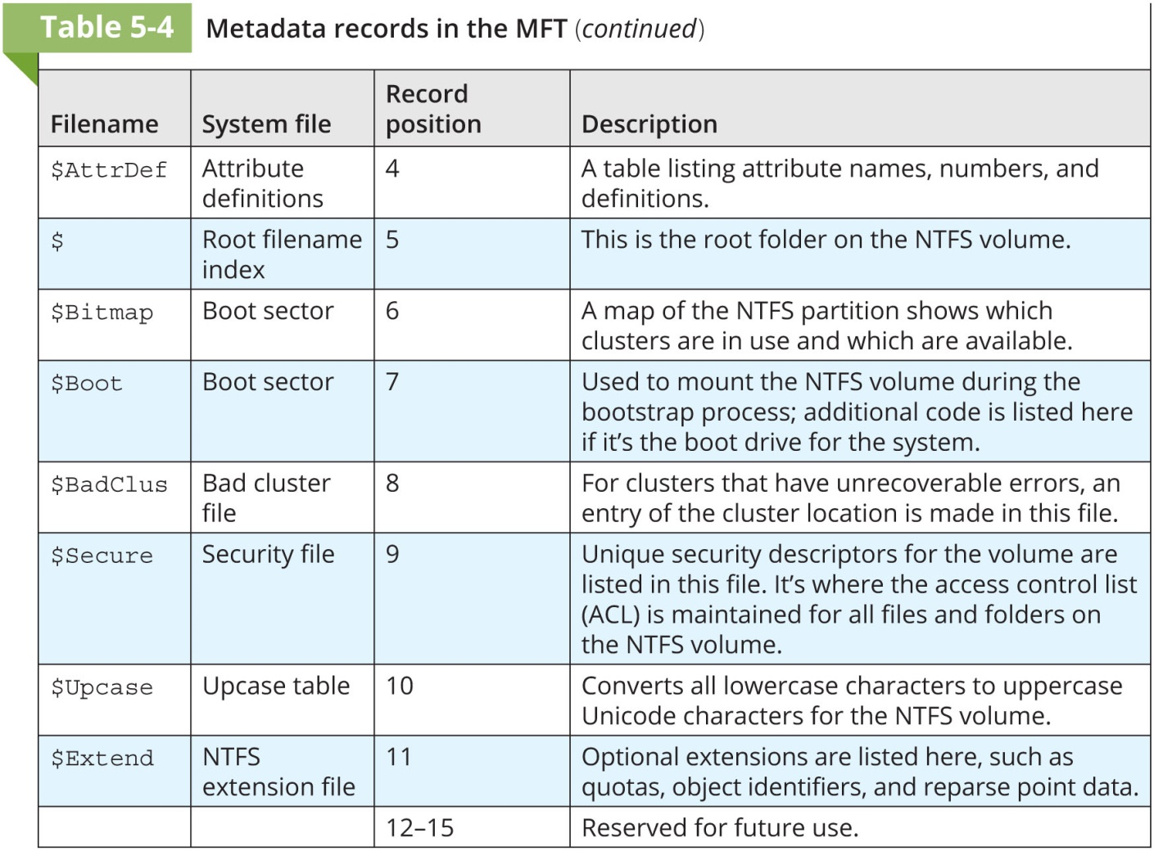
NTFS File System (3 of 3)

Slide 35
MFT and File Attributes (1 of 7)
In the NTFS MFT
All files and folders are stored in separate records of 1024 bytes each
Each record contains file or folder information
This information is divided into record fields containing metadata
A record field is referred to as an attribute ID
File or folder information is typically stored in one of two ways in an MFT record:
Resident and nonresident

Slide 36
MFT and File Attributes (2 of 7)
Files larger than 512 bytes are stored outside the MFT
MFT record provides cluster addresses where the file is stored on the drive’s partition
Referred to as data runs
Each MFT record starts with a header identifying it as a resident or nonresident attribute

Slide 37
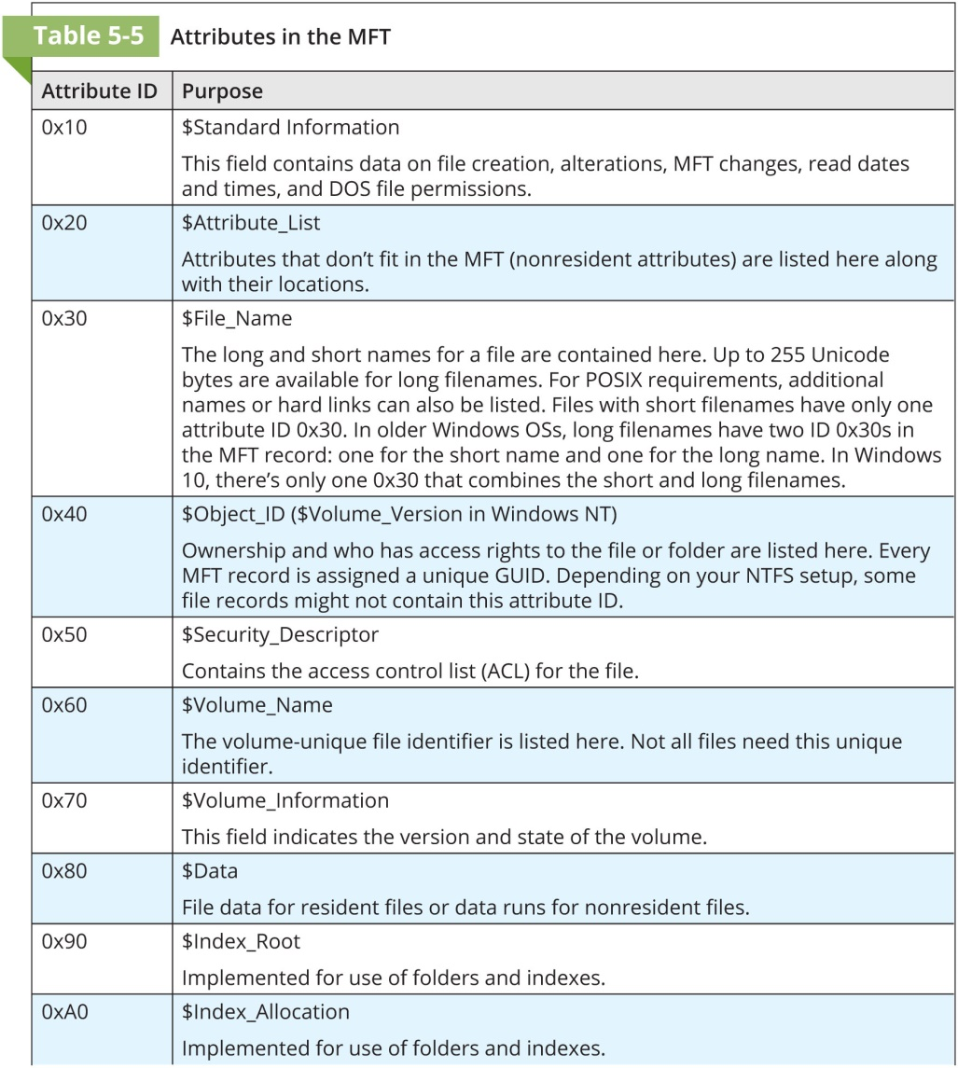
MFT and File Attributes (3 of 7)

Slide 38
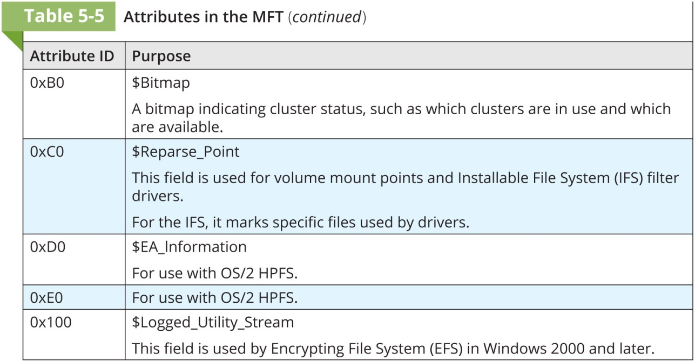
MFT and File Attributes (4 of 7)

Slide 39
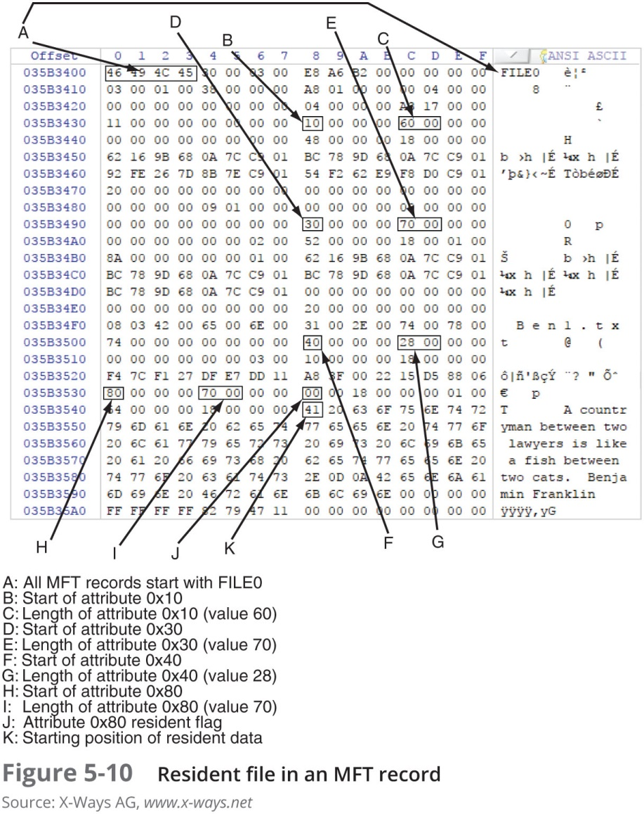
MFT and File Attributes (5 of 7)

Slide 40
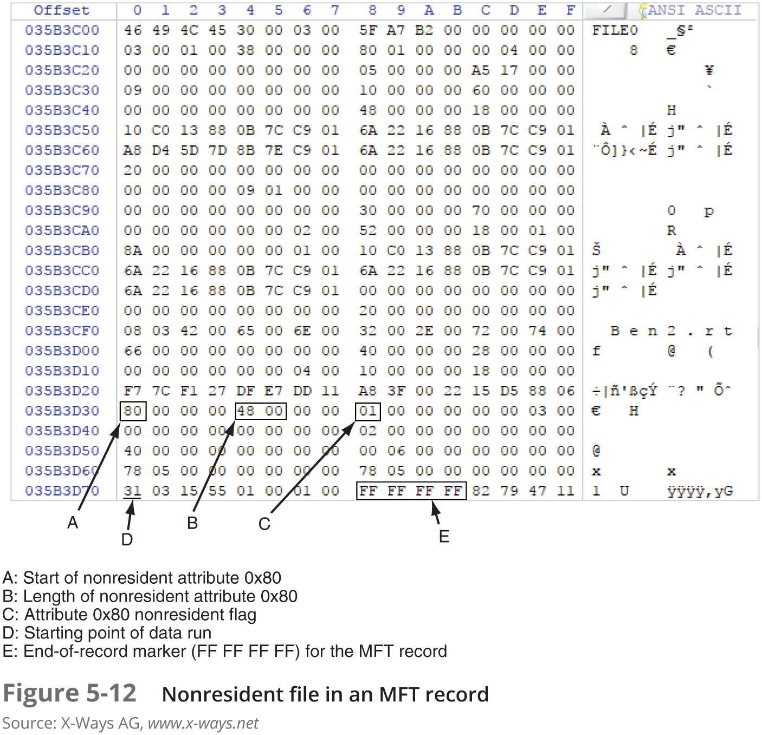
MFT and File Attributes (6 of 7)

Slide 41
MFT and File Attributes (7 of 7)
When a disk is created as an NTFS file structure
OS assigns logical clusters to the entire disk partition
These assigned clusters are called logical cluster numbers (LCNs)
Become the addresses that allow the MFT to link to nonresident files on the disk’s partition
When data is first written to nonresident files, an LCN address is assigned to the file
This LCN becomes the file’s virtual cluster number (VCN)

Slide 42
MFT Structures for File Data (1 of 7)
For the header of all MFT records, the record fields of interest are as follows:
At offset 0x00 - the MFT record identifier FILE
At offset 0x1C to 0x1F - size of the MFT record
At offset 0x14 - length of the header (indicates where the next attribute starts)
At offset 0x32 and 0x33 - the update sequence array, which stores the last 2 bytes of the first sector of the MFT record

Slide 43
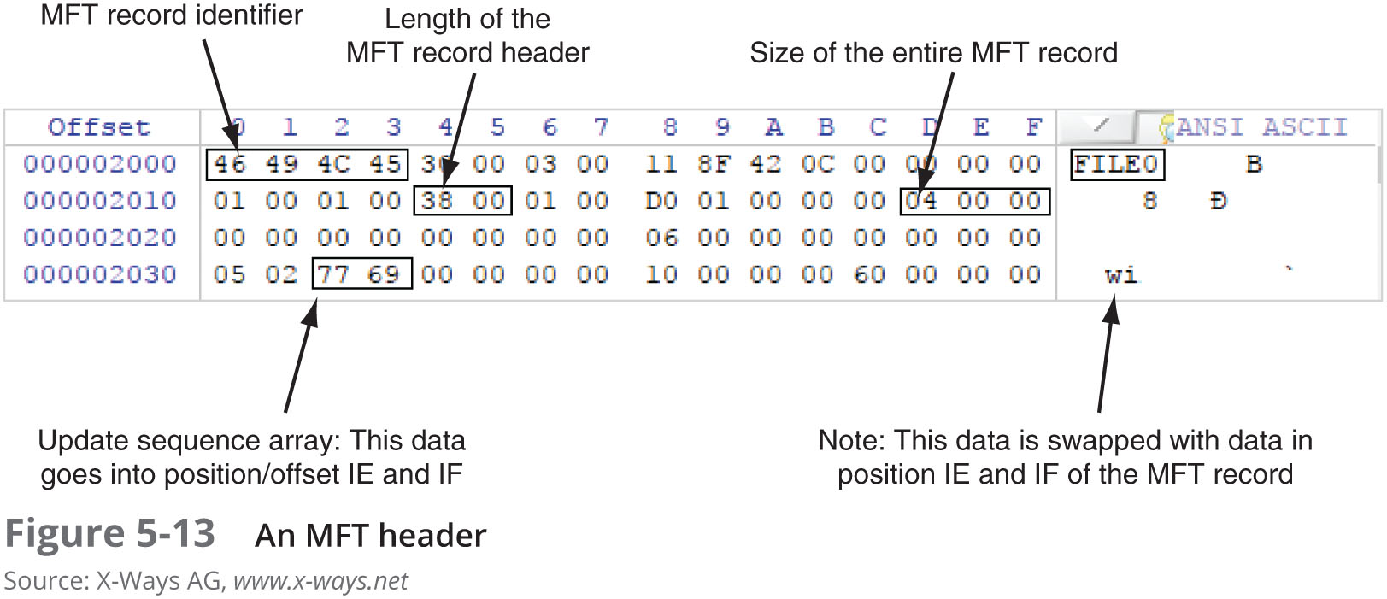
MFT Structures for File Data (2 of 7)

Slide 44
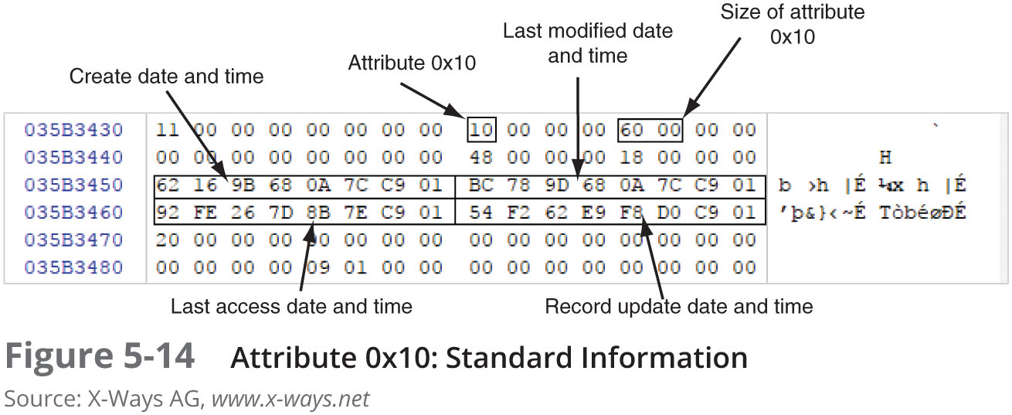
MFT Structures for File Data (3 of 7)

Slide 45
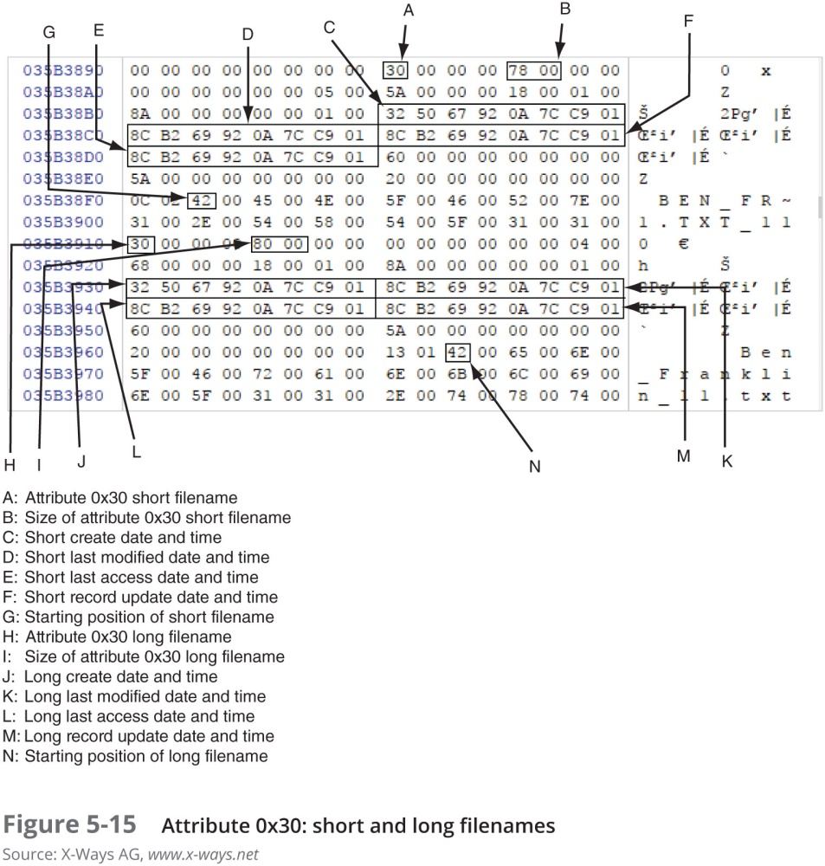
MFT Structures for File Data (4 of 7)

Slide 46
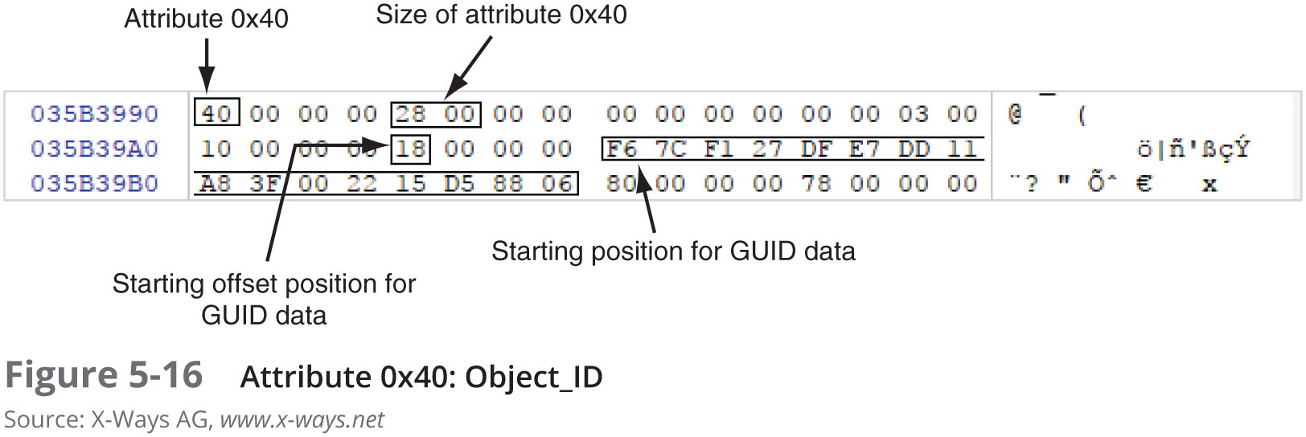
MFT Structures for File Data (5 of 7)

Slide 47
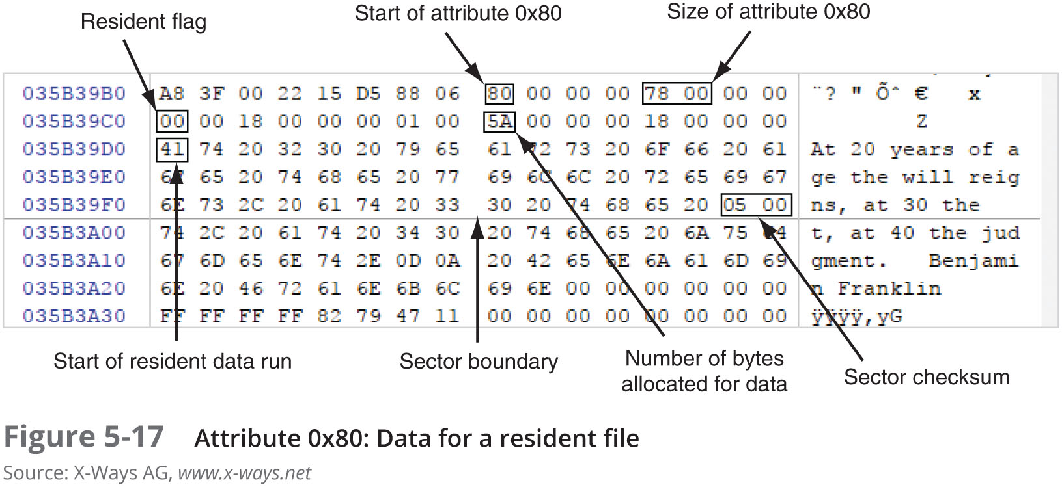
MFT Structures for File Data (6 of 7)

Slide 48
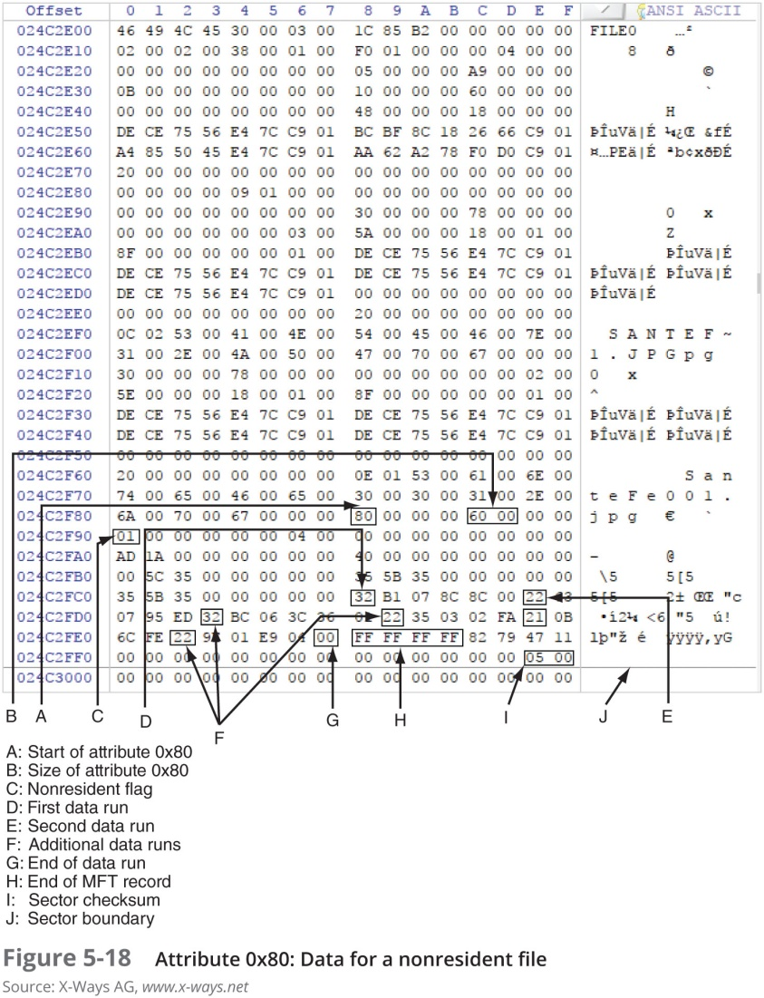
MFT Structures for File Data (7 of 7)

Slide 49
NTFS Alternate Data Streams (1 of 2)
Alternate data streams
Ways data can be appended to existing files
Can obscure valuable evidentiary data, intentionally or by coincidence
In NTFS, an alternate data stream becomes an additional file attribute
Allows the file to be associated with different applications
You can only tell whether a file has a data stream attached by examining that file’s MFT entry

Slide 50
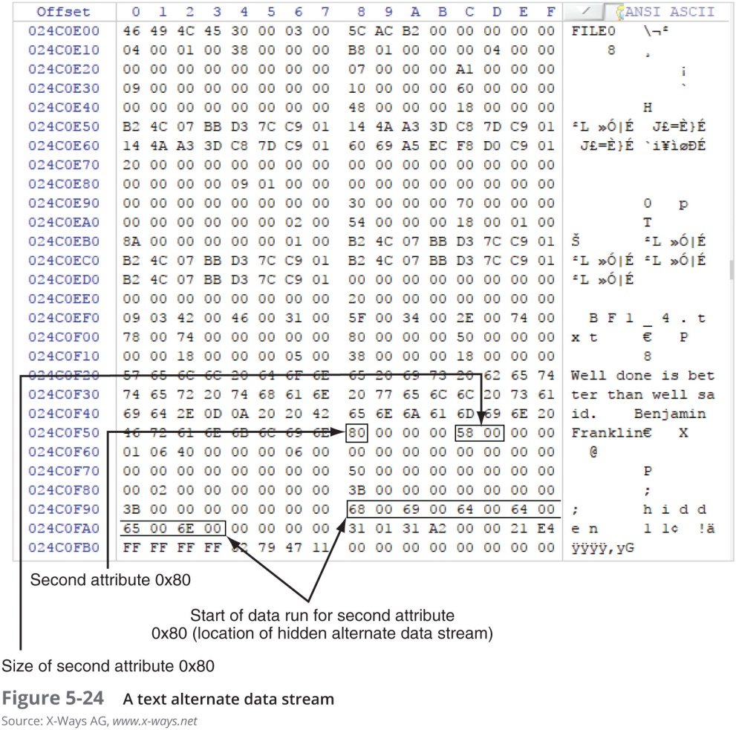
NTFS Alternate Data Streams (2 of 2)

Slide 51
NTFS Compressed Files
NTFS provides compression similar to FAT DriveSpace 3 (a Windows 98 compression utility)
With NTFS, files, folders, or entire volumes can be compressed
Most computer forensics tools can uncompress and analyze compressed Windows data

Slide 52
NTFS Encrypting File System (EFS)
Encrypting File System (EFS)
Introduced with Windows 2000
Implements a public key and private key method of encrypting files, folders, or disk volumes
When EFS is used in Windows 2000 and later
A recovery certificate is generated and sent to the local Windows administrator account
Users can apply EFS to files stored on their local workstations or a remote server

Slide 53
EFS Recovery Key Agent
Recovery Key Agent implements the recovery certificate
Which is in the Windows administrator account
Windows administrators can recover a key in two ways: through Windows or from a command prompt
Commands:
cipher
copy

Slide 54
Deleting NTFS Files
When a file is deleted in Windows NT and later
The OS renames it and moves it to the Recycle Bin
Can use the del (delete) MS-DOS command
Eliminates the file from the MFT listing in the same way FAT does

Slide 55
Resilient File System
Resilient File System (ReFS) - designed to address very large data storage needs
Such as the cloud
Features incorporated into ReFS’s design:
Maximized data availability
Improved data integrity
Designed for scalability
ReFS uses disk structures similar to the MFT in NTFS

Slide 56
Understanding Whole Disk Encryption (1 of 3)
In recent years, there has been more concern about loss of
Personal identity information (PII) and trade secrets caused by computer theft
Of particular concern is the theft of laptop computers and handheld devices
To help prevent loss of information, software vendors now provide whole disk encryption

Slide 57
Understanding Whole Disk Encryption (2 of 3)
Current whole disk encryption tools offer the following features:
Preboot authentication
Full or partial disk encryption with secure hibernation
Advanced encryption algorithms
Key management function

Slide 58
Understanding Whole Disk Encryption (3 of 3)
Whole disk encryption tools encrypt each sector of a drive separately
Many of these tools encrypt the drive’s boot sector
To prevent any efforts to bypass the secured drive’s partition
To examine an encrypted drive, decrypt it first
Run a vendor-specific program to decrypt the drive
Many vendors use a bootable CD or USB drive that prompts for a one-time passphrase

Slide 59
Examining Microsoft BitLocker
Available Vista Enterprise/Ultimate, Windows 7, 8, and 10 Professional/Enterprise, and Server 2008 and later
Hardware and software requirements
A computer capable of running Windows Vista or later
The TPM microchip, version 1.2 or newer
A computer BIOS compliant with Trusted Computing Group (TCG)
Two NTFS partitions
The BIOS configured so that the hard drive boots first before checking other bootable peripherals

Slide 60
Examining Third-Party Disk Encryption Tools
Some available third-party WDE utilities:
Endpoint Encryption
Voltage SecureFile
Jetico BestCrypt Volume Encryption

Slide 61
Understanding the Windows Registry
Registry
A database that stores hardware and software configuration information, network connections, user preferences, and setup information
To view the Registry, you can use:
Regedit (Registry Editor) program for Windows 9x systems
Regedt32 for Windows 2000, XP, and Vista
Both utilities can be used for Windows 7 and 8

Slide 62
Exploring the Organization of the Windows Registry (1 of 5)
Registry terminology:
Registry
Registry Editor
HKEY
Key
Subkey
Branch
Value
Default value
Hives

Slide 63
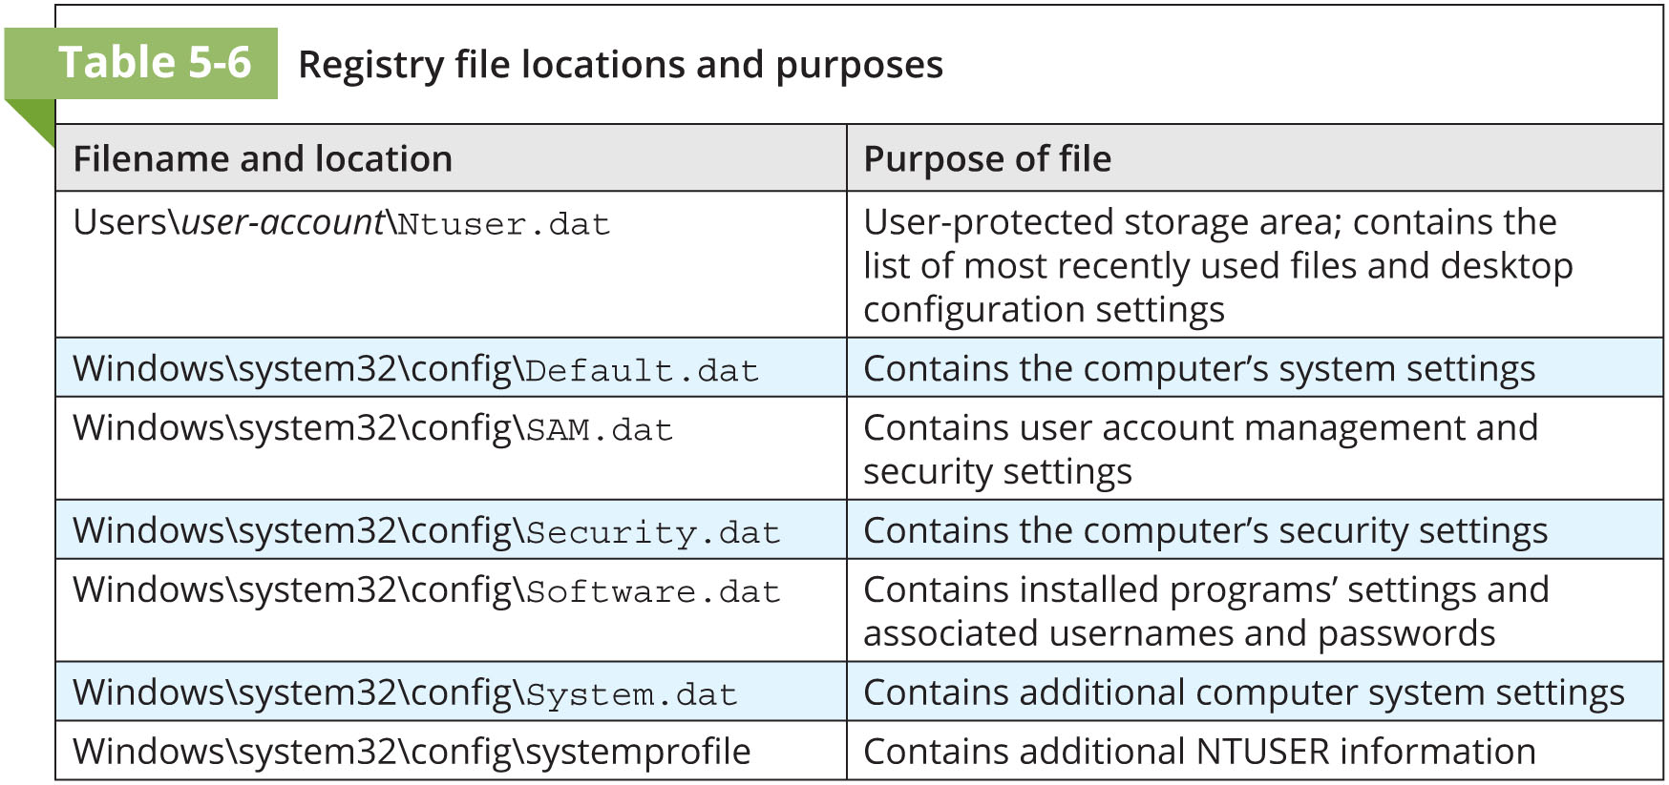
Exploring the Organization of the Windows Registry (2 of 5)

Slide 64
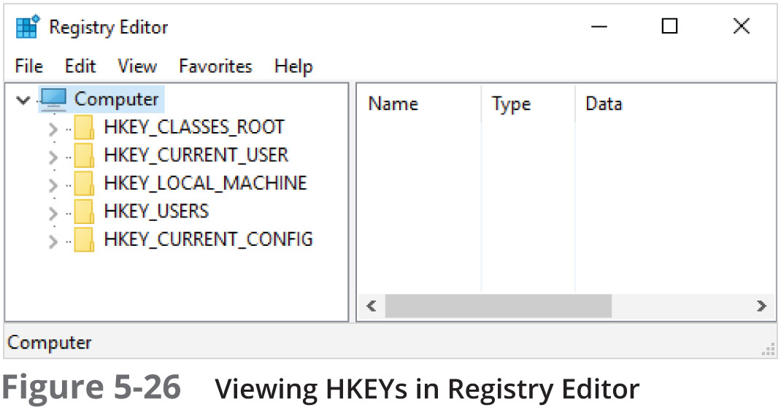
Exploring the Organization of the Windows Registry (3 of 5)

Slide 65
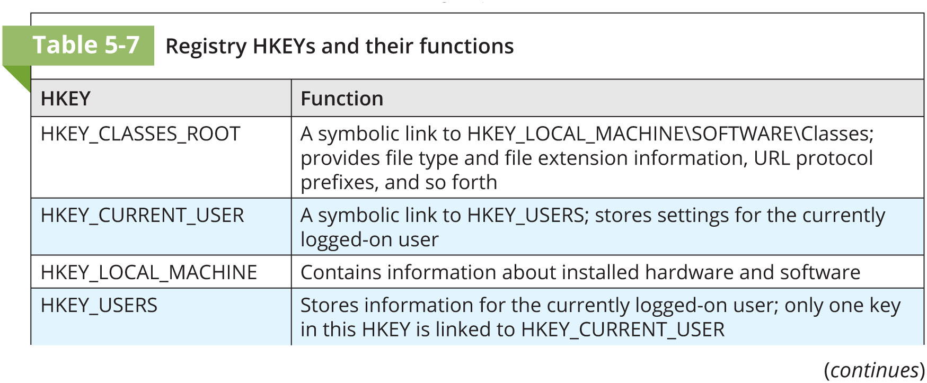
Exploring the Organization of the Windows Registry (4 of 5)

Slide 66
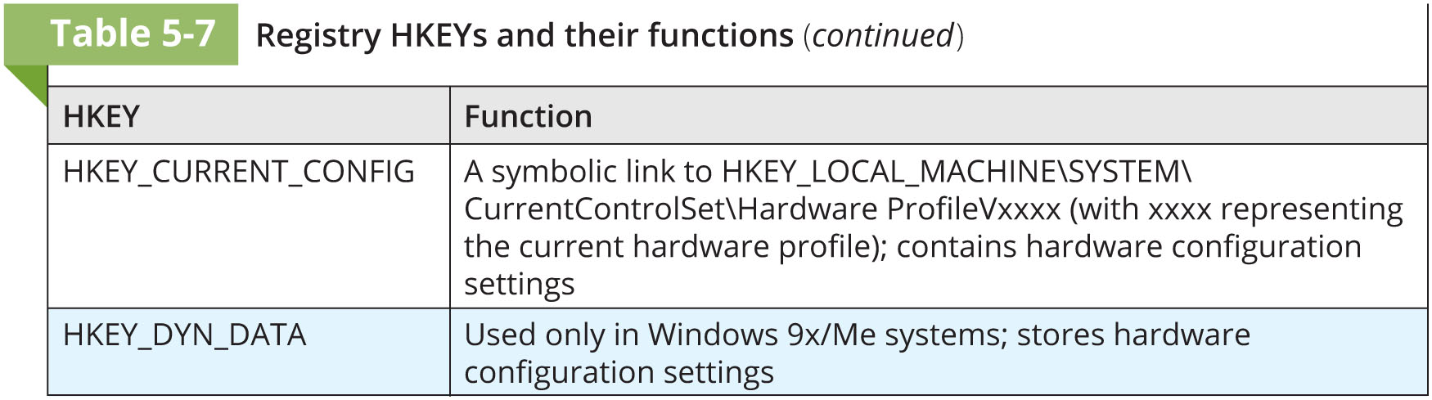
Exploring the Organization of the Windows Registry (5 of 5)

Slide 67
Examining the Windows Registry (1 of 2)
Tools with built-in or add-on Registry viewers:
X-Ways Forensics
OSForensics
Forensic Explorer
FTK

Slide 68
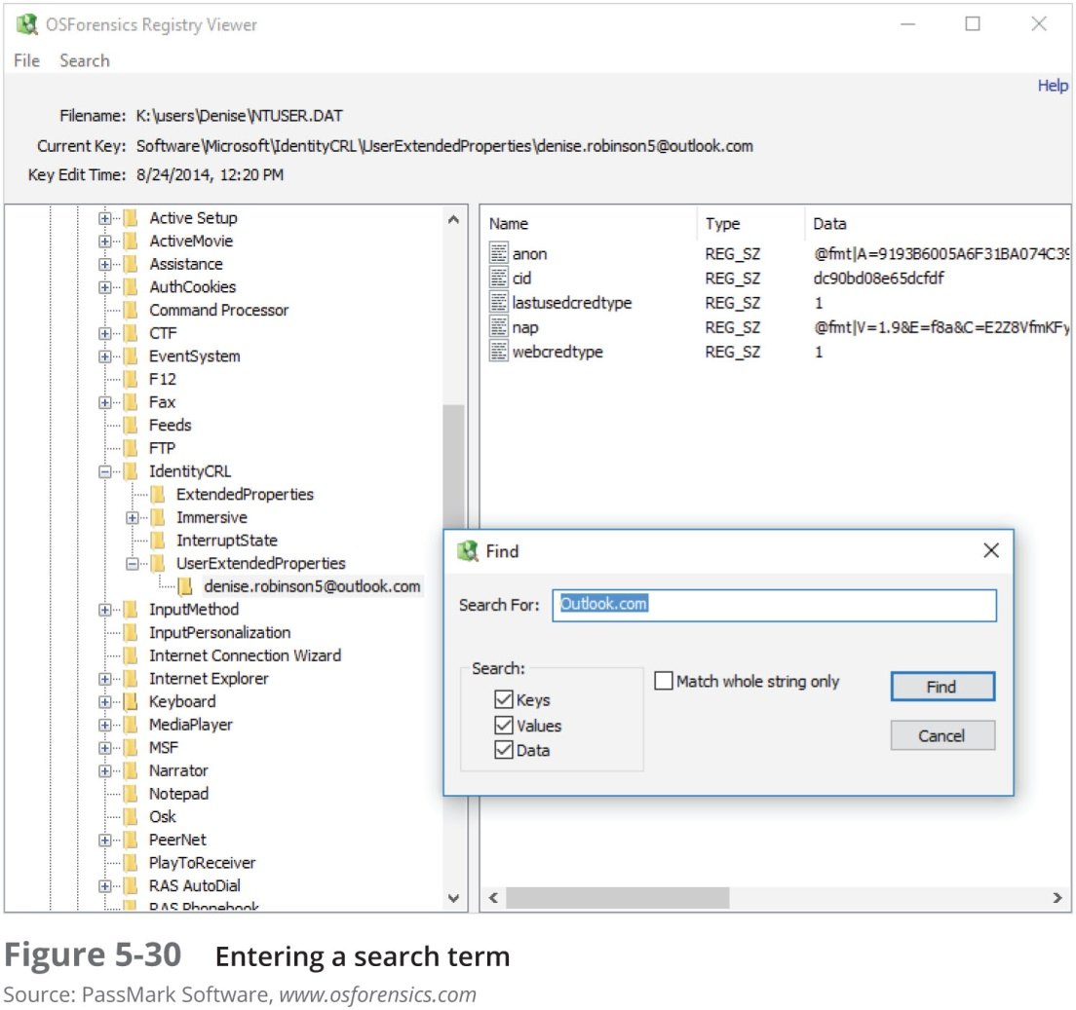
Examining the Windows Registry (2 of 2)

Slide 69
Understanding Microsoft Startup Tasks
Learn what files are accessed when Windows starts
This information helps you determine when a suspect’s computer was last accessed
Important with computers that might have been used after an incident was reported

Slide 70
Startup in Windows 7, Windows 8 and Windows 10
Windows 8 and 10 are multiplatform OSs
Can run on desktops, laptops, tablets, and smartphones
The boot process uses a boot configuration data (BCD) store
The BCD contains the boot loader that initiates the system’s bootstrap process
Press F8 or F12 when the system starts to access the Advanced Boot Options

Slide 71
Startup in Windows NT and Later (1 of 5)
All NTFS computers perform the following steps when the computer is turned on:
Power-on self test (POST)
Initial startup
Boot loader
Hardware detection and configuration
Kernel loading
User logon

Slide 72
Startup in Windows NT and Later (2 of 5)
Startup Files for Windows Vista:
The Ntldr program in Windows XP used to load the OS has been replaced with these three boot utilities:
Bootmgr.exe
Winload.exe
Winresume.exe
Windows Vista includes the BCD editor for modifying boot options and updating the BCD registry file
The BCD store replaces the Windows XP boot.ini file

Slide 73
Startup in Windows NT and Later (3 of 5)
Startup Files for Windows XP:
NT Loader (NTLDR)
Boot.ini
Ntoskrnl.exe
Bootvid.dll
Hal.dll
BootSect.dos
NTDetect.com
NTBootdd.sys
Pagefile.sys
Device drivers
Contain instructions for the OS for hardware devices

Slide 74
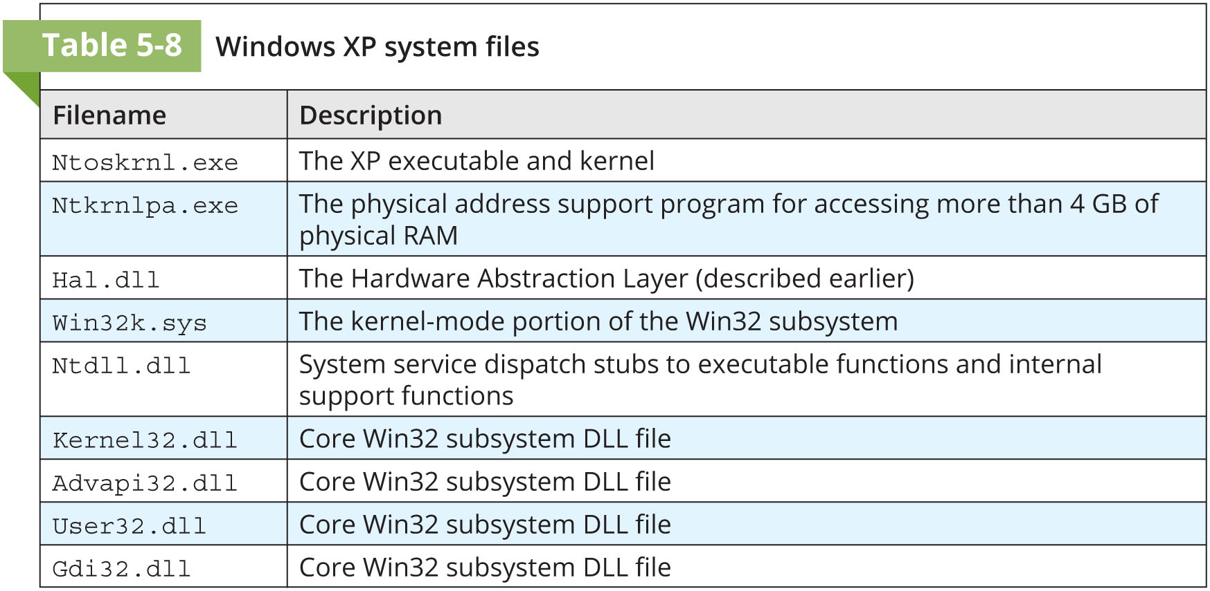
Startup in Windows NT and Later (4 of 5)

Slide 75
Startup in Windows NT and Later (5 of 5)
Contamination Concerns with Windows XP
When you start a Windows XP NTFS workstation, several files are accessed immediately
The last access date and time stamp for the files change to the current date and time
Destroys any potential evidence
That shows when a Windows XP workstation was last used

Slide 76
Understanding Virtual Machines (1 of 3)
Virtual machines
Enable you to run another OS on an existing physical computer (known as the host computer) by emulating a computer’s hardware environment
A virtual machine is just a few files on your hard drive
Must allocate space to it
A virtual machine recognizes components of the physical machine it’s loaded on
Virtual OS is limited by the physical machine’s OS

Slide 77
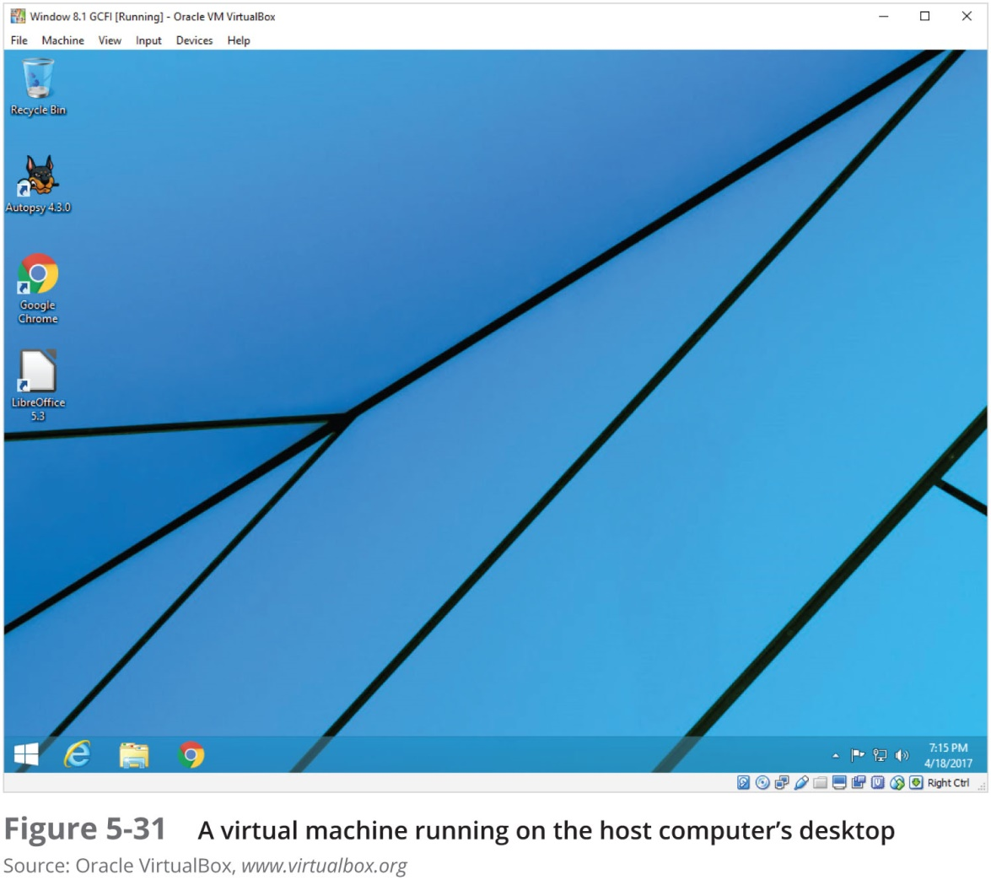
Understanding Virtual Machines (2 of 3)

Slide 78
Understanding Virtual Machines (3 of 3)
In digital forensics
Virtual machines make it possible to restore a suspect drive on your virtual machine
And run nonstandard software the suspect might have loaded
From a network forensics standpoint, you need to be aware of some potential issues, such as:
A virtual machine used to attack another system or network

Slide 79
Creating a Virtual Machine
Common applications for creating virtual machines
VMware Server, VMware Player and VMware Workstation, Oracle VM VirtualBox, Microsoft Virtual PC, and Hyper-V
Using VirtualBox
An open-source program (download)
Consult with your instructor before doing the activities using VirtualBox

Slide 80
Summary (1 of 3)
When starting a suspect’s computer, using boot media, such as forensic boot CDs or USB drives, you must ensure that disk evidence isn’t altered
The Master Boot Record (MBR) stores information about partitions on a disk
Microsoft used FAT12 and FAT16 on older operating systems
To find a hard disk’s capacity, use the cylinders, heads, and sectors (CHS) calculation

Slide 81
Summary (2 of 3)
When files are deleted in a FAT file system, the hexadecimal value 0x05 is inserted in the first character of the filename in the directory
NTFS is more versatile because it uses the Master File Table (MFT) to track file information
Records in the MFT contain attribute IDs that store metadata about files
In NTFS, alternate data streams can obscure information that might be of evidentiary value

Slide 82
Summary (3 of 3)
File slack, RAM slack, and drive slack are areas in which valuable information can reside on a drive
NTFS can encrypt data with EFS and BitLocker
NTFS can compress files, folders, or volumes
Windows Registry keeps a record of attached hardware, user preferences, network connections, and installed software
Virtualization software enables you to run other OSs on a host computer

